Slide 1
Continuous Integration / Continuous Delivery
Institutionalizing CICD in IHS

Slide 2
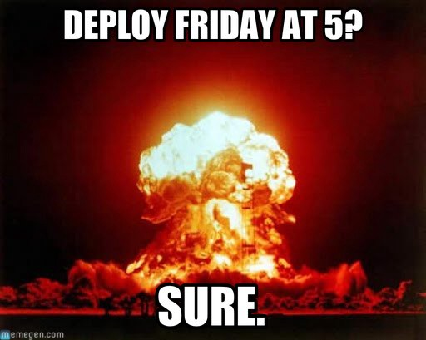
Why CI-CD?
Ensure code stability
Automate testing
Version controlling
Maintain code quality
Code reviews
Automate deployment
Fast… with Runners

Slide 3
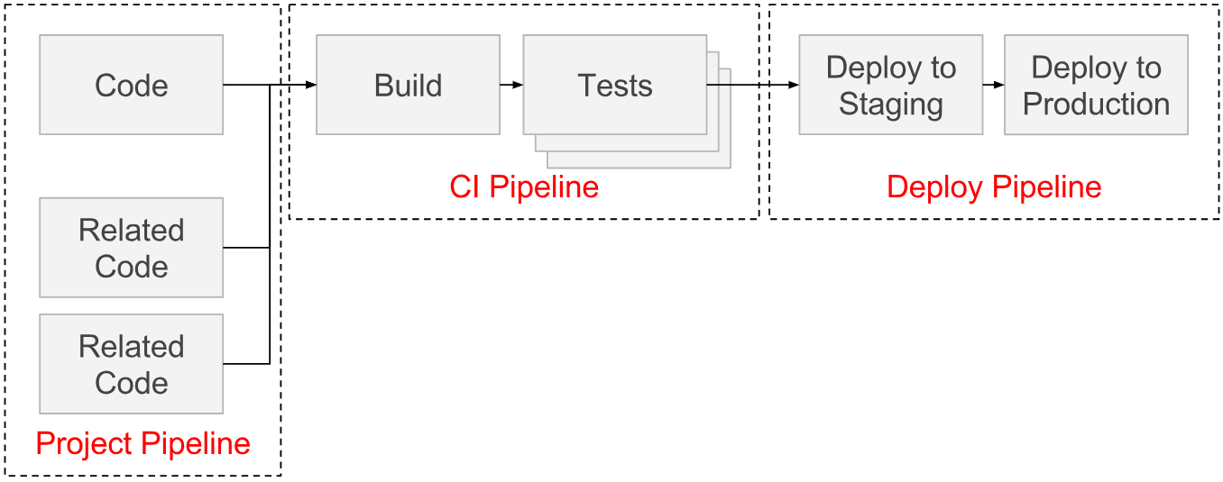
CI-CD Pipelines (simple)

Slide 4
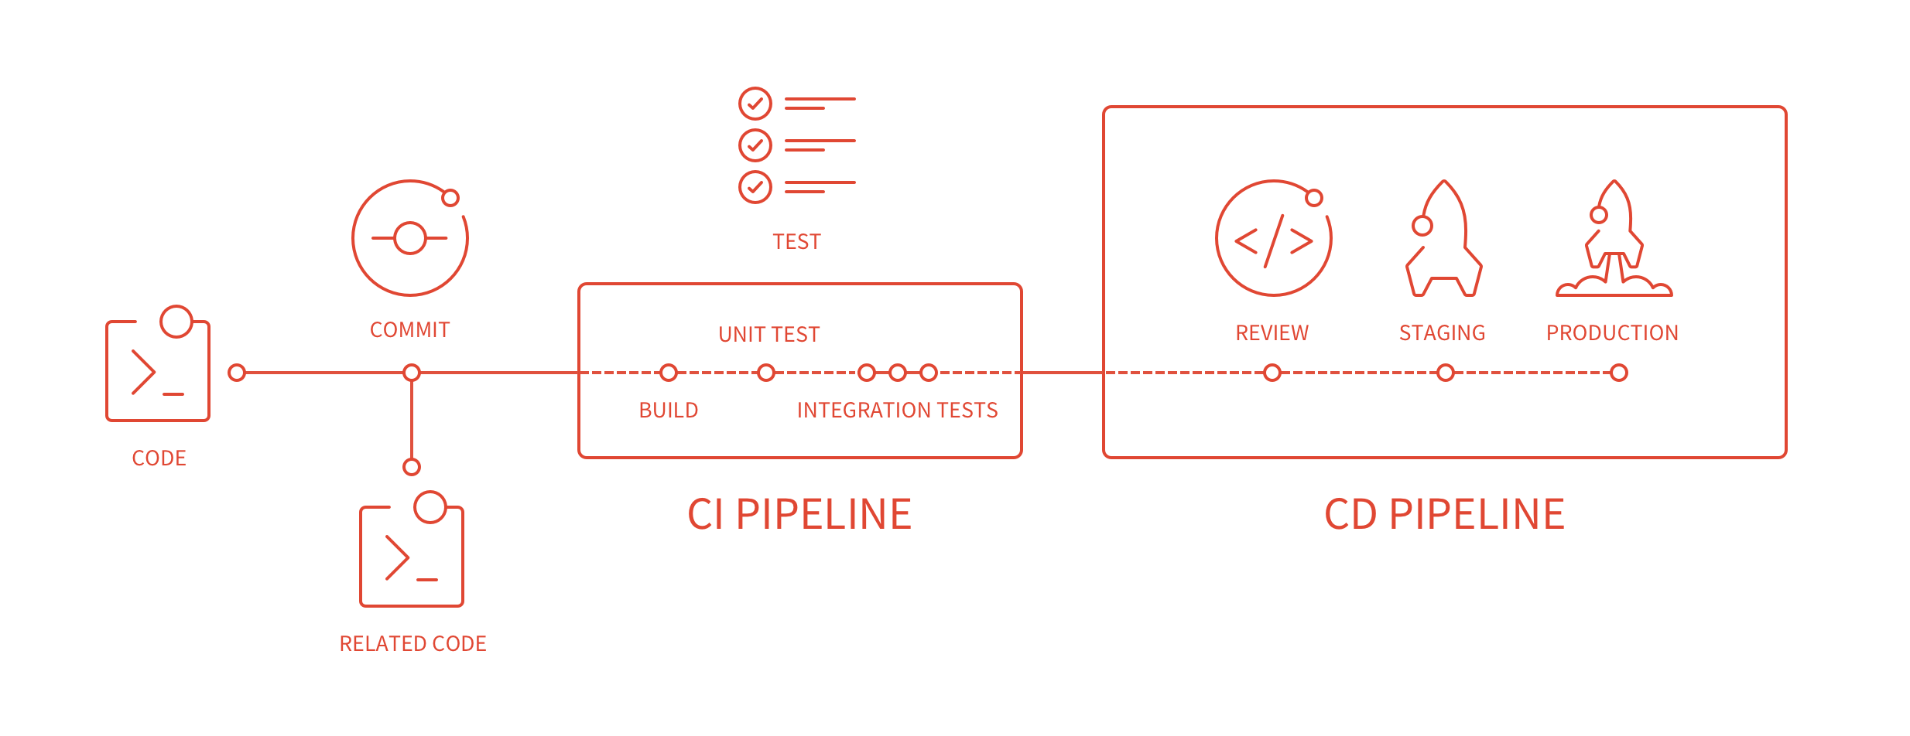
CI-CD Pipelines

Slide 5
CICD Prerequisites
Standardize development workflow
Automated testing
Build management
Version control system
Code quality control
Deployment platform
Monitoring and improvement

Slide 6
Standardize Development Workflow
Branch Flow:
Separate branches for each feature
Code moves from Dev to production
Users work on a designated branches only
Trunk-based
Single branch called master
Separate feature branches
Fork-based
Separate user repositories
Pull requests

Slide 7
Proposed Development Workflow
Trunk-based workflow
Allows projects to be private or internal
Protected master branch
Contributors added explicitly
One branch (or tag) per feature
Inter-branch pull requests
More customized CICD process (e.g. run only on master commit)

Slide 8
Proposed Development Workflow
Local Machine
Code
Dev. Branch
Test suites
Master Level
Integration test
Unit testing
Local linting
Linting with SonarQube
Comments
Create artifacts
Create release
Build/package
Deployment
Pick “feed”
Push “feed”
Deployment
Validation
Performance test
Promote to PRODUCTION
Backup

Slide 9
Automated Testing
Unit testing
Component testing
Performance testing
Integration testing

Slide 10
Build Management
Deprecate file-based management
Maven or Gradle or Ant (last resort)
Strict SemVer
Service layer
Data schema
Client-ends

Slide 11
Code Quality Control
Automated quality test with SonarCube
Test Coverage:
Minimum: 50%
Optimal: 60 to 80%
Waste of time: >80%
Peer reviews (made easy in Fork-based workflows)

Slide 12
Deployment Platform
Consistency between Environments:
Developer: frequently changed (without notice)
Testing: frequently reset
Demonstration: periodically reset, production clone
Production
Docker
Ready images
Single or Separate containers
Steep learning curve

Slide 13
CI Maturity Levels
Level 0:
Daily code commits
No code on GitLab with syntax errors
Production build is same as master build

Slide 14
CI Maturity Levels
Level 1:
Separate branch against every bug fix/change/feature
No failed tests on master branch
Code on master branch is peer reviewed
Release notes contain every ticket worked upon

Slide 15
CI Maturity Levels
Level 2:
No test failures in any branch
Separate unit test against each ticket
Test coverage over 60%
No issues flagged critical on SonarQube
Every pull request is reviewed before acceptance
Each module versioned using SemVer order
Documentation is auto-regenerated

Slide 16
CD Maturity Levels
Level 0:
Artifact packaging (e.g. war builds)
Artifact uploads to a registry (e.g. Docker image to Amazon ECR) for testing

Slide 17
CD Maturity Levels
Level 1:
Automated pre-deployment data backup
Release notes automation
Documentation updates on Wiki
Zero down-time production upgrade

Slide 18
CD Maturity Levels
Level 2:
Zero-touch deployment to production on each merger with master branch
Automated Agile-board updates
Monitoring with Prometheus monitoring
Continuous improvement with Kaizen and Six Sigma

Slide 19
Tentative Timeline
2019Q1
Dev. Workflow
2019Q2
Unit Testing
2019Q3
Environment consistency
2020Q1
Automated review
2020Q3
Coverage reports
2020Q4
CI – Level 1
CD – Level 0
Peer review
Build Management
Performance Testing
DB version control

Slide 20
What’s next?
Continuous Delivery Maturity Model

Slide 21
 | Culture & Organization | Design & Architecture | Build & Deploy | Quality Assurance | Reporting
Baseline | Defined process Prioritize client WBS and predefined timelines | Consolidated technologies Modular architecture | Versioned code base Scripted builds Documented manual deployments | Automated unit tests Separate testing environment Issue tracking | Manual reporting Qualitative quality metrics
Beginner | One backlog per team Adopt basic Agile process Shared incentives/penalty on success/failure | Version control DB Change management Library management File-based configuration | Scheduled builds (CI) Dedicated build server Scripts to automate deployment | Automated integration tests Code reviews | Automated code analysis reports Quantitative quality metrics
Intermediate | Prioritize members Inter-team collaboration Common change process Decentralized decisions Dedicated Dev & Ops Introduce performance metrics | Consistent branching structure Platform-level configuration management Feature hiding Integrated issue tracking | Build storage Manual tagging/versioning Build once, deploy many Basic deployment pipeline (CD) | Performance tests Some automated acceptance tests Peer code reviews | Traceability built into pipeline Report history storage Live dashboards
Advanced | Dedicated specialists for each tool Continuous improvement (Kaizen/Six Sigma) | Microservice architecture Artifact management | Zero downtime for deployment (CD) Institutionalized Build/deploy process | Automated security tests Disaster recovery | Graphics as a service Trend analysis Data mining
Expert | Prioritize teams Zero rollbacks, always move forward No process bypasses Cross functional teams | Complete Agile process | Zero touch continuous deployment Build bakery | Expected business value verification Continuous optimization of processes | AI-based decision support

Slide 22
Checklist
Client’s requests should be broken into unit tasks.
Separate ticket should be created against each task.
ALL tickets should be placed on Agile board.
Separate branch should be created for each ticket.
Progress and percentage of completion should be regularly updated on ticket.
Code should be merged only when:
Unit test(s) to test the specific ticket are created and pass
Properly documented code according to conventions
All tests in the suite pass
Both date and time are met in meeting timelines.
Projects should be checked for test coverage.

